Slide 1

CMSC 137
Data Communications and Networking
Lecture Module
12 – Data Link Layer

Slide 2
Module 12: Data Link Layer
Rozano S. Maniaol
Lecturer

Slide 3
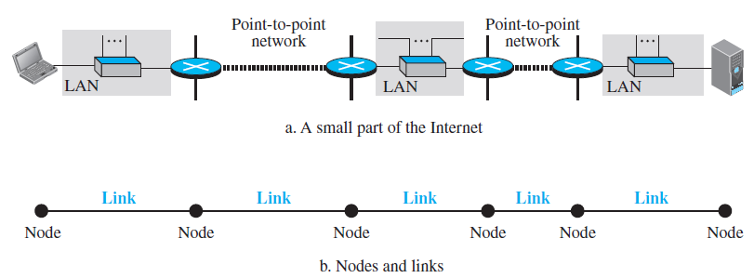
Introduction
TCP/IP Protocol Suite does not define any protocol in the data link or physical layer
The data link layer transforms the physical layer to a link responsible for node to node communication
It is customary to refer to end hosts and the routers as nodes and the network in between as links

Slide 4
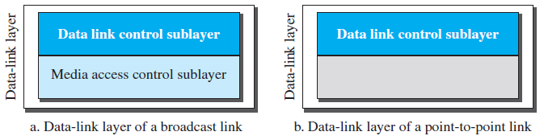
Introduction
Main functions are data link control and media access control
Two Categories of Link
  Point-to-point link – link is dedicated to the two devices
  Broadcast link – link is shared between several pairs of devices
Two Sublayers

Slide 5
Services
Framing
Flow Control
Error Control
Media Access Control
Link Layer Addressing

Slide 6
Link Layer Addressing

Slide 7
Link Layer Addressing
In a connectionless internetwork such as the Internet, we cannot make a datagram reach its destination using only IP addresses
Source and destination IP address define the 2 ends but cannot define which links the datagram should pass
Another addressing mechanism needed in connectionless internetwork: link layer address / physical address / MAC address

Slide 8
Types of Addresses
Unicast address – used in one to one communication
  In Ethernet, addresses are 48 bits (six bytes) presented as 12 hexadecimal digits separated by colons; a unicast address has an even number in the second digit in hexadecimal
  Ex. A2:34:45:11:92:F1
Multicast address – used in one-to-many communication but the jurisdiction is local (inside the link)
  In Ethernet, the second digit is an odd number in hexadecimal
  Ex. A3:34:45:11:92:F1

Slide 9
Types of Addresses
Broadcast address – one-to-all communication; frame with destination broadcast address is sent to all entities in the link
  In Ethernet, the 48 bits are all 1s that are presented as 12 hexadecimal digits separated by colons
  Ex. FF:FF:FF:FF:FF:FF

Slide 10
Error Correction and Detection

Slide 11
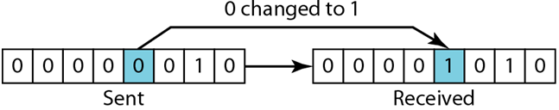
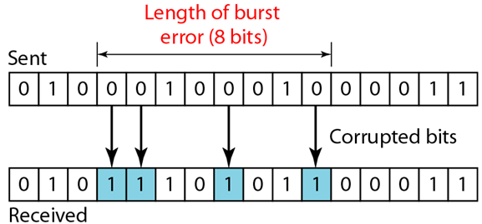
Error Detection and Correction
Data can be corrupted during transmission because of interference
Types of Errors
  Single-bit errors – only 1 bit is changed in the data unit
  Burst errors – two or more bits have changed, length is measured from the first corrupted bit to the last corrupted bit
    Affected bits
    depend on data
    rate and noise
    duration

Slide 12
Error Detection and Correction
Redundancy
  To be able to detect or correct errors, extra bits are needed with data
  Redundant bits are added by the sender and removed by the receiver
Detection vs. Correction
  Detection – did errors occur?
  Correction – need to know the exact number of corrupted bits and exact location

Slide 13
Error Detection and Correction
Forward Error Correction
  Receiver tries to guess the message by using redundant bits
Re-transmission
  Receiver detects an error and asks the sender to resend the message
Coding
  Creates a relationship between redundant bits and actual data bits; block coding and convolution coding

Slide 14
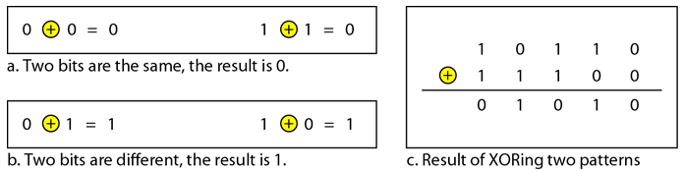
Modulo Arithmetic
Modulo-2
  Adding
    0+0=0, 0+1=1, 1+0=1, 1+1=0
  Subtracting
    0-0=0, 0-1=1, 1-0=1, 1-1=0
  Adding and subtracting yields the same results
  We can use XOR for both addition and subtraction

Slide 15
Block Coding

Slide 16
Block Coding
Divide message into blocks, each of k bits, called datawords
We add r redundant bits to each block to make the length n = k+ r, the n-bit blocks are called codewords
With k bits, we can have 2^{k} data words, with n bits we can have 2^{n} codewords
Same dataword is always encoded as the same codeword
2^{n} – 2^{k} codewords are not used (illegal/invalid)
  Existence of these illegal codewords is the trick in error detection

Slide 17
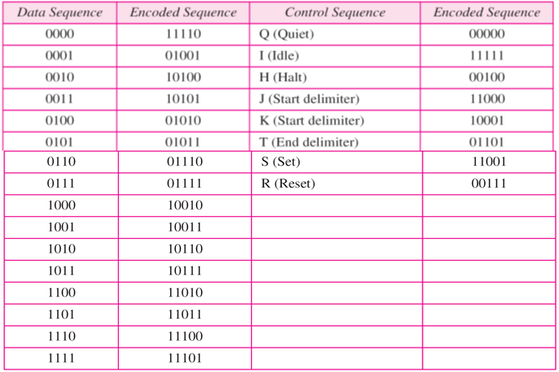
4B/5B Block Coding
k=4,n=5
2^{k} = 2⁴ = 16 datawords
2^{n} = 2⁵ = 32 codewords

Slide 18
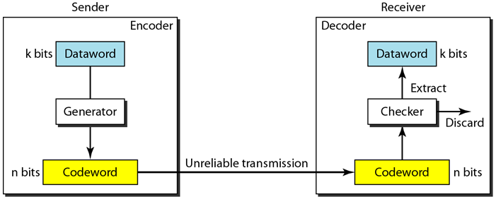
Block Coding: Error Detection
Conditions to detect
  Receiver has/can find a list of valid codewords
  Original codeword has changed to an invalid one
An error-detecting code can only detect the types of error for which it is designed; other types of error may remain undetected

Slide 19
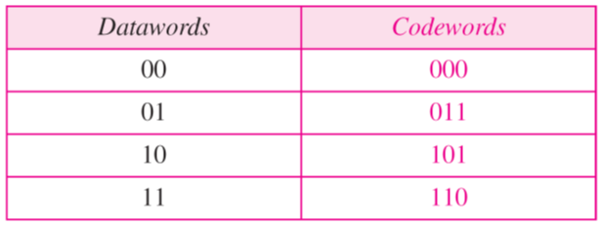
Block Coding: Error Detection
Table A
*This can only detect single bit errors
Example: Sender encodes 01 as 011
Cases:
  Receiver gets 011 - valid
  Receiver gets 111 - invalid
  Receiver gets 000 – undetected error

Slide 20
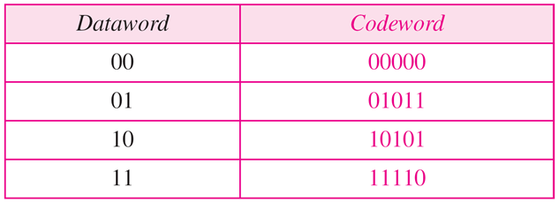
Block Coding: Error Correction
Table B
Sender encodes 01 as 01011
Receiver gets 01001
Codeword not in table
Assumes that 1 bit is corrupted
Not first, third, fourth – 2 bits in error
Must be the second!

Slide 21
Hamming Distance
The number of differences between the corresponding bits between two words
d(x,y)
The Hamming Distance between the received codeword and the sent codeword is the number of bits that are corrupted during transmission
Use XOR and count the number of 1's in the result
Ex.: d(000,011)=2, d(10101,11110)=3

Slide 22
Minimum Hamming Distance
Smallest hamming distance between all possible pairs of the codewords: d_{min}
From Table A: C(3,2), d_{min}=2
  d(000,011)=2, d(000,101)=2, d(000,110)=2,
  d(011,101)=2, d(011,110)=2, d(101,110)=2
From Table B: C(5,2), d_{min}=3
  d(00000,01011)=3, d(00000,10101)=3, d(00000,11110)=4,
  d(01011,10101)=4, d(01011,11110)=3, d(10101,11110)=3
Any coding scheme needs to have at least three parameters: codeword size n, dataword size k, and d_{min}

Slide 23
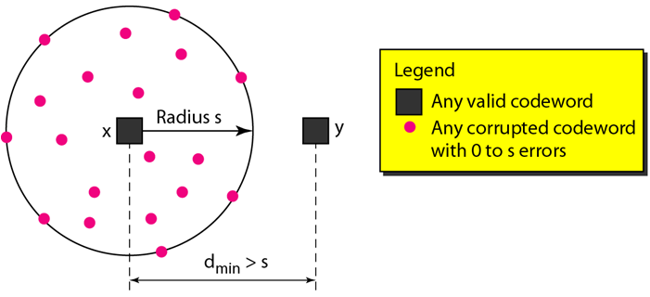
Minimum Hamming Distance
To guarantee detection of up to s errors in all cases, the minimum Hamming distance in a block code must be d_{min} = s + 1

Slide 24
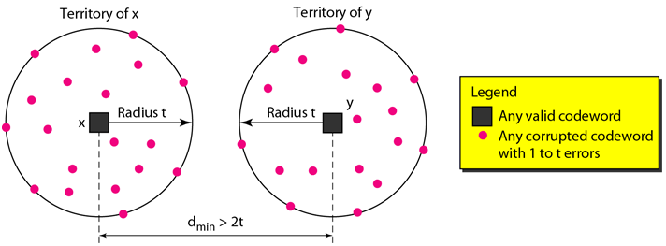
Minimum Hamming Distance
To guarantee correction of up to t errors in all cases, the minimum Hamming distance in a block code must be d_{min}= 2t + 1

Slide 25
Linear Block Codes
Almost all block codes used today belong to a subset of block codes called linear block codes
A code in which the XOR of two valid codewords creates another valid codeword
Minimum hamming distance is the number of 1's in the nonzero valid codeword with the smallest number of 1's
In Table A, number of 1's in the nonzero codewords are 2 (011), 2 (101), and 2 (110); d_{min}=2
In Table B, number of 1's in the nonzero codewords are 3 (01011), 3 (10101), and 4 (11110) ; d_{min}=3

Slide 26
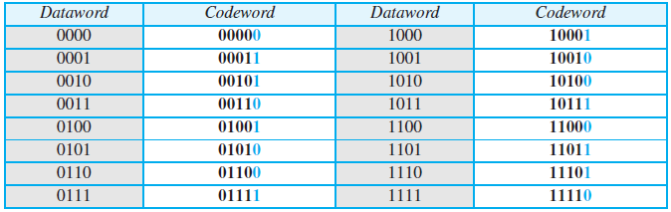
Simple Parity Check
A single-bit error-detecting code in which n=k+1 with d_{min}=2
Can only detect an odd number of errors
Simple Parity Check code C(5,4)

Slide 27
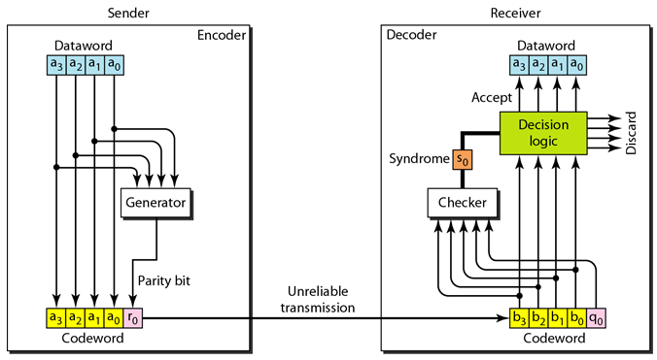
Simple Parity Check
r₀ = a₃ + a₂ + a₁ + a₀ (modulo-2)
number of 1's is even, result is 0; number of 1's is odd result is 1
s₀ = b₃ + b₂ + b₁ + b₀ + q₀ (modulo-2)
syndrome is 0 when the number of 1's in the received codeword is even; otherwise, it is 1

Slide 28
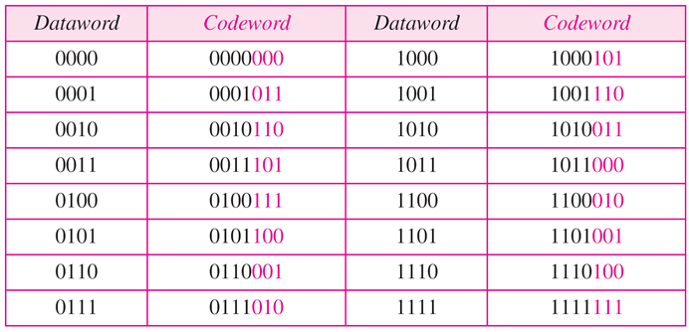
Cyclic Codes
Special linear block codes in which if a codeword is cyclically shifted (rotated), the result is another codeword
Ex. 1011000, perform a SHL, 0110001
Ex. Cyclic Redundancy Check (CRC)
CRC Code with C(7,4)

Slide 29
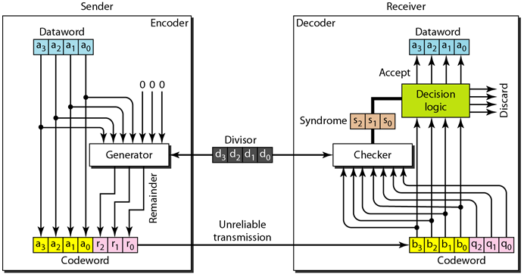
CRC

Slide 30
CRC Encoder
Dataword has k bits, codewords has n bits
Size of dataword is augmented by adding n – k zeros to the righthand side
n-bit result is fed into generator
Generator use a divisor of size n-k+1, predefined and agreed upon
Divisor divides augmented dataword by divisor (modulo-2 division)
Remainder is appended to dataword to create codeword

Slide 31
CRC Encoder
Dataword
Quotient
1
0
1
0
Discard
1001
Divisor 1 0 1 1
1 0 0 1
0
0
0
Dividend
1 0 1 1
0 1 0
Leftmost bit 0:
Use 0000 as divisor
0
0 0 0 0
1 0 0
0
1 0 1 1
Note:
Multiply: AND
Subtract: XOR
0 1 1
0
0 0 0 0
1 1 0
Remainder
Codeword
1001
110
Encoder
Dataword
Remainder

Slide 32
CRC Decoder
Decoder receives a possibly corrupted codeword
n bits fed to the checker, replica of generator
Remainder produced by checker is a syndrome of n-k bits
If syndrome bits are all 0's, k leftmost bits of the codeword are accepted as dataword

Slide 33
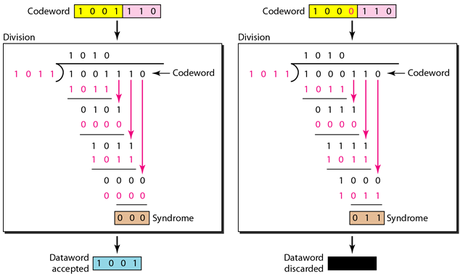
CRC Decoder

Slide 34
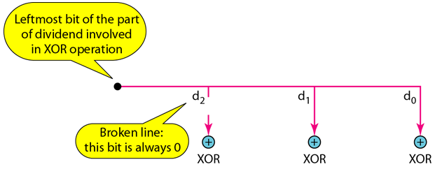
CRC
Good performance in detecting single bit errors, double errors, odd number of errors, burst errors
Easily implemented in hardware and software
Hardware implementation is fast

Slide 35
Checksum
Error-detecting technique that can be applied to a message of any length
In the Internet, it is mostly used at the network and transport layer
At the source, the message is first divided into m-bit units. The generator then creates an extra m-bit unit called the checksum which is sent with the message
At the destination, the checker creates a new checksum from the combination of the message and the sent checksum. If the new checksum is all 0’s, the message is accepted; otherwise it is discarded

Slide 36
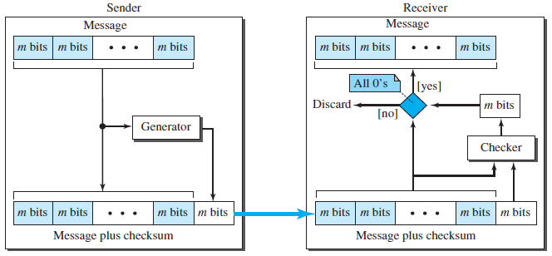
Checksum

Slide 37
Checksum
Concept
Suppose data is five 4-bit numbers: (7,11,12,0,6)
We send (7,11,12,0,6, 36), sum is 36
Receiver adds the five number and compares result to the sum
If we send the negative of the sum: (7,11,12,0,6, -36), receiver simply adds everything and a result of zero is expected

Slide 38
Checksum
In the previous example, the checksum,-36, cannot be written as a four bit word
Use one's complement arithmetic
  Unsigned numbers between 0 to 2^{n}-1 using only n bits
  If the number has more than n bits, extra leftmost bits are added to the n rightmost bits
    Ex. 36 using 4 bits is 6;
    100100 0100 + 10 = 0110
  Negative number can be represented by inverting all bits

Slide 39
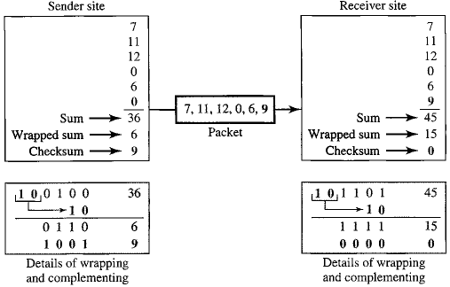
Checksum

Slide 40
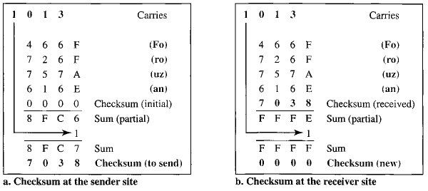
Checksum
Traditionally, the Internet has been using the 16-bit checksum

Slide 41
References
Forouzan, B.A. 2013. Data Communications and Networking, 5th Ed. McGraw-Hill, New York.

